Slide 1
DESIGN PATTERNS

Slide 2
Introduction
Solution for common problems
They are tried and tested solutions
Contains- Intend, Motivation, structure and code example
Classification of patterns
  Creational Pattern
  Structural Pattern
  Behavioral Pattern

Slide 3
Creational Pattern
Object creation mechanism for flexible and reusable.
  Factory Method
  Abstract Factory
  Builder
  Prototype
  Singleton

Slide 4
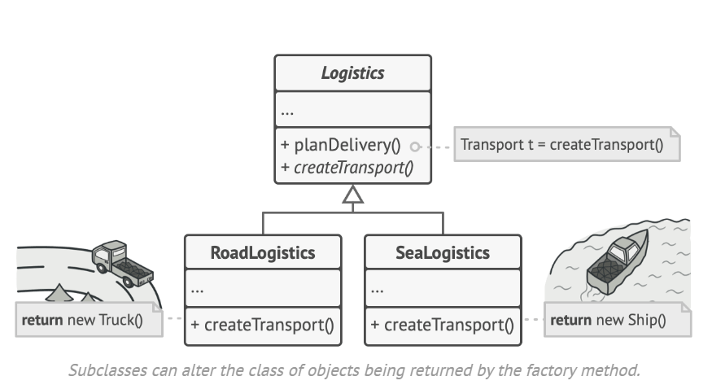
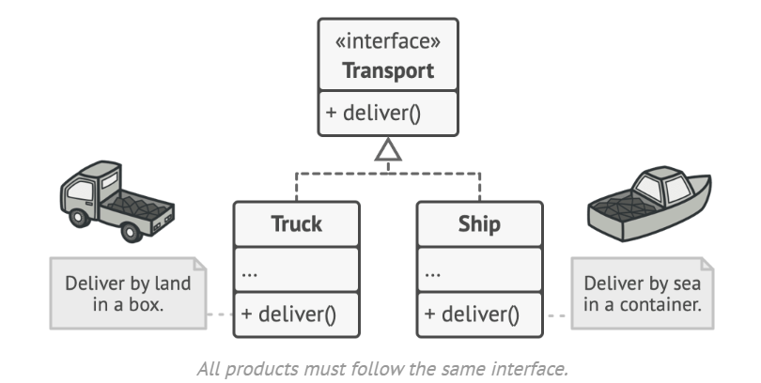
Factory Method
Intent: The Factory Method pattern defines an interface for creating an object but allows subclasses to alter the type of objects that will be created.
Implementation: In this pattern, a superclass provides a method for creating objects, but the specific subclasses implement this method to produce objects of different types.
Example: Suppose you have a Vehicle superclass with subclasses Truck, and Ship. Each subclass provides its own implementation of a createTransport method to instantiate an object of its type.
Disadvantages:
Can lead to a proliferation of subclasses if there are many variations of the product
Advantages:
Encapsulates the object creation logic, providing flexibility in choosing the object to be created.
Allows subclasses to decide which class to instantiate..

Slide 5
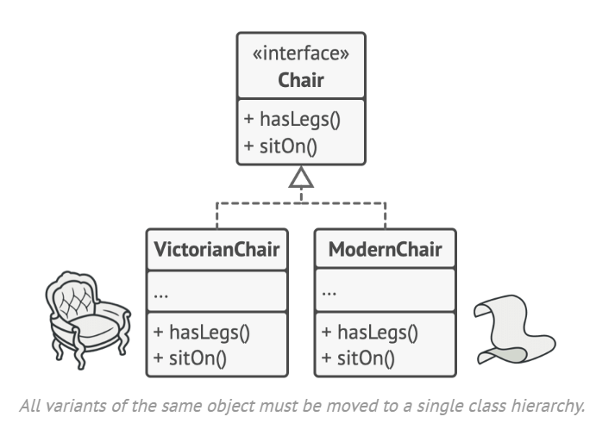
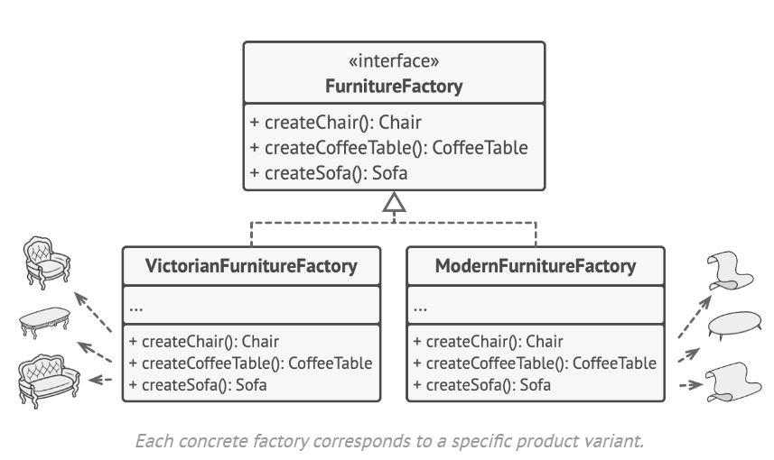
Abstract Factory
Intent: The Abstract Factory pattern provides an interface for creating families of related or dependent objects without specifying their concrete classes.
Implementation: Abstract factory defines a set of methods, each of which returns a different type of object. Concrete subclasses of the abstract factory implement these methods to produce objects of a specific type.
Example- Explicitly declare interfaces for each distinct product of the product family (e.g., chair, sofa or coffee table). Then you can make all variants of products follow those interfaces. Then declare the Abstract Factory—an interface with a list of creation methods for all products that are part of the product family (for example, createChair, createSofa and createCoffeeTable).
Advantages:
Ensures that the created objects are compatible with each other.
Provides an interface for creating families of related or dependent objects.
Disadvantages:
Adding new products to the factory may require changes to the interface, affecting all concrete implementations.

Slide 6
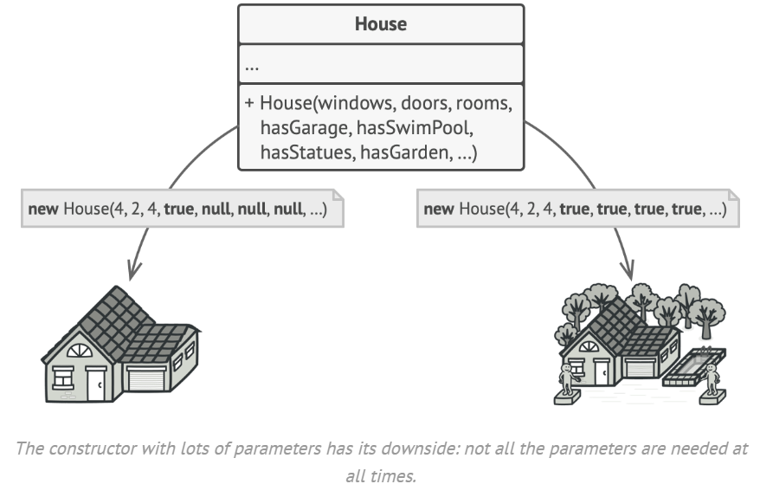
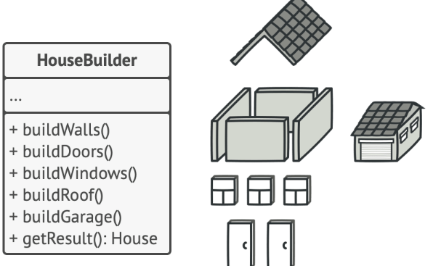
Builder
Builder is a creational design pattern that lets you construct complex objects step by step. The pattern allows you to produce different types and representations of an object using the same construction code.
Implementation:
  Builder Interface: Defines the steps required to construct the product.
  Concrete Builders: Implements the builder interface to construct and assemble parts of the product.
  Director: Manages the construction process using the builder interface.
  Product: The complex object being constructed.
To build a simple house, you need to construct four walls and a floor, install a door, fit a pair of windows, and build a roof. But what if you want a bigger, brighter house, with a backyard and other goodies
The simplest solution is to extend the base House class and create a set of subclasses to cover all combinations of the parameters. But eventually you’ll end up with a considerable number of subclasses.
The Builder pattern suggests that you extract the object construction code out of its own class and move it to separate objects called builders.
To create an object, you execute a series of these steps on a builder object. The important part is that you don’t need to call all of the steps. You can call only those steps that are necessary for producing a particular configuration of an object.

Slide 7
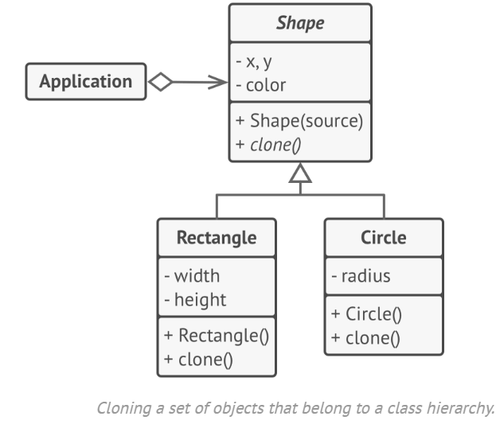
Prototype or Clone
Intent- Prototype is a creational design pattern that lets you copy existing objects without making your code dependent on their classes.
Implementation:
Prototype Interface: Defines a method for cloning itself.
Concrete Prototypes: Implement the prototype interface and provide an implementation of the clone method to create a copy of the object.
Client: Requests new objects to be created by cloning the prototype.
All shape classes follow the same interface, which provides a cloning method. A subclass may call the parent’s cloning method before copying its own field values to the resulting object.
Advantages:
Reduces the complexity of creating new objects by copying existing ones.
Allows for adding or removing concrete prototypes at runtime.
Disadvantage:
Cloning complex objects that have circular references might be very tricky.

Slide 8
Singleton
Intent- Singleton is a creational design pattern that lets you ensure that a class has only one instance, while providing a global access point to this instance.
The Singleton pattern solves two problems at the same time, violating the Single Responsibility Principle-
Ensure that a class has just a single instance. Note that this behavior is impossible to implement with a regular constructor since a constructor call must always return a new object by design.
Provide a global access point to that instance. Just like a global variable, the Singleton pattern lets you access some object from anywhere in the program. However, it also protects that instance from being overwritten by other code.
Implementations
Make the default constructor private, to prevent other objects from using the new operator with the Singleton class.
Create a static creation method that acts as a constructor. Under the hood, this method calls the private constructor to create an object and saves it in a static field. All following calls to this method return the cached object.
Advantages:
Ensures that only one instance of the class exists throughout the application.
Provides a global point of access to that instance.
Lazily initialized, which means the singleton instance is created only when it's first requested.

Slide 9
Structural Pattern
Structural design patterns explain how to assemble objects and classes into larger structures, while keeping these structures flexible and efficient.
  Adapter
  Bridge
  Composite
  Decorator
  Flyweight
  Proxy

Slide 10
Adapter
Intent- Adapter is a structural design pattern that allows objects with incompatible interfaces to collaborate.

